Slide 1
nv20 Developer Workshop
Pixel Shading Lab: Minnaert Shading
November 30, 2000
Notes:
Change this to match slides for rest of kitchen

Slide 2
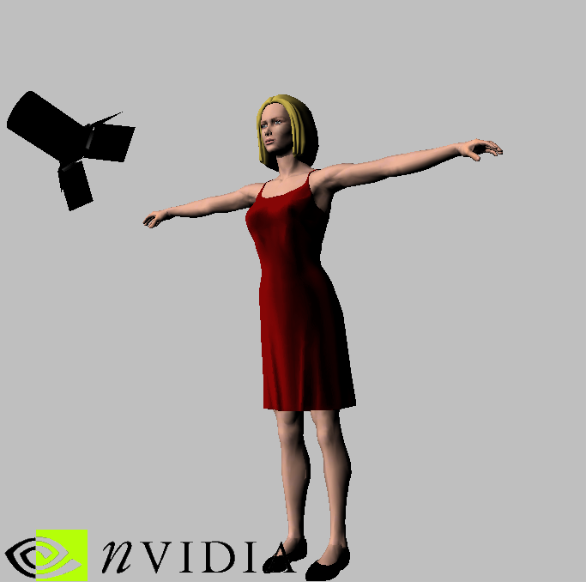
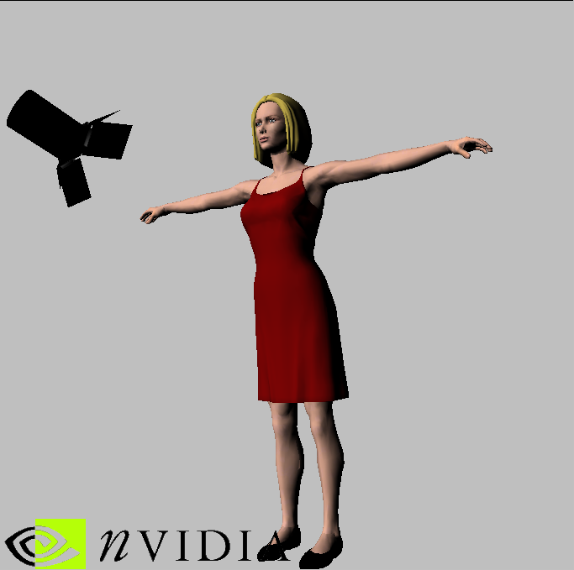
Pixel Shading Lab: Minnaert Shading
Kenneth Hurley (khurley@nvidia.com)
Minnaert Shading Gouraud Shading

Slide 3
Overview
Minnaert Shading –
  Minnaert, M., 1941. The reciprocity principle in lunar photometry. Astrophysical Journal, Volume 93, pp. 403-410.
Subtle shading technique for Anistropic lighting effects
Darkening limbs (edges, WRT eye/light)
Portion of BRDF (Bidirectional Refelectance Distribution Function) calculations.

Slide 4
Overview (Cont.)
Map that is used to look up
  Color * (cos()^{k} * cos()^{1-k})
  ❑ = Angle between Light and Normal
   = Angle between Eye and Normal
Eye
Normal
(E • N) = 
(L • N) = 
Light

Slide 5
Overview (Cont.)
Basic principle is that you use the Light (L) vector dotted with Normal (N), per pixel, take the cosine and raise it to a power. This is multiplied with the Eye (E) dotted with the Normal (N)
What does this do?
  Creates a self shadowing effect on a per pixel basis, taking the Light vector and Eye position into account.
This value is used to modulate the pixel color for shadowing effects.

Slide 6
CPU Steps
We set up 2 textures for the operation on CPU
  Texture at stage 0 is Normalization Cubemap
  Texture at stage 2 is the precomputed Minnaert texture
    Precomputed Texture is (L • N)^{k} for X Coordinate (S for OpenGL), (E • N)^{1-k} For Y Coordinate (T for OpenGL) multiplied together.
Setup Light Direction Vector and Eye position in Constant Memory

Slide 7
Vertex Shader Steps
Vertex Shader simply passes Normal and Light Direction in Texture Coordinates 0, 1
  Eye Vector is calculate from Eye Position and Vertex Position, then renormalized and placed in Texture Coordinate 2
  ; get vertex position to eye position (-eye vector)
  sub r0, c[CV_EYE_POSITION], srcPosition
  ; normalize the new vector
  dp3 r0.w, r0, r0
  rsq r0.w, r0.w
  mul destEyeTex, r0, r0.w ; destEyeTex coordinate now has normalized vector vertex->eye
  mov destEyeTex.w, c[CV_ONE]

Slide 8
A couple of things to know about Pixel Shaders
T0-T3 come in as Texture coordinates –infinity to infinity. As soon as you read (sample) a texture, they turn into RGB values and the texture coordinates are lost forever.
  However, you can keep the texture coordinates by using the opcode “texcoord”
Reading a T(0-3) register in the Addressing Operations precludes it from being read in the non-addressing operations

Slide 9
A couple of things to know about Pixel Shaders (Cont.)
_bx2
  Biases and Scales the source register
    Since RGB is in the Range of 0..255 this effectively treats 0 = -1, 0x80 = 0, and 255 = 1 and remaps these values to the actual –1 to 1 range before operation is carried out.
  Useful for converting RGB values into Vectors. (examples include Bump Maps, Renormalization Map).

Slide 10
Pixel Shader Steps
Use T0 (Normal)
  Renormalize on a pixel by pixel basis using cubemap to lookup vector
    tex t0
T1 Coordinate contains -Light Vector
T2 Coordinate contains -Eye Vector
T1, T2 aren’t normalized on pixel by pixel basis. It would be nice, but it isn’t possible.

Slide 11
Pixel Shader Steps (Cont)
Use texm3x2pad
  texm3x2pad t1, t0_bx2
  This is a dot product between T0 and T1, effectively performs first row of matrix multiply.
    Results are stored in a non-accessible temporary register (U_{tmp}) (S_{tmp}, for OpenGL)
      Used as first coordinate (U) (S, for OpenGL) for texture lookup for next instruction
    This does not read (sample) a texture. It just uses the texture coordinates T1 and what’s in register T0
This performs the function:
  U_{tmp} = T1_{str} • ([(T0_{rgb}) -.05] * 2)

Slide 12
Pixel Shader Steps (Cont)
Use texm3x2tex
  texm3x2tex t2, t0_bx2
  This is a dot product between T0 and T2, effectively performs second row of matrix multiply.
    Results are stored in a non-accessible temporary register (V_{tmp}) (T_{tmp}, for OpenGL)
      Used as second coordinate (V) (T, for OpenGL) for texture lookup
    This instruction then reads (samples) a texture based on (U_{tmp,} V_{tmp}).
This looks up the precomputed power functions of (L • N) and (E • N)

Slide 13
Pixel Shader Steps (Cont)
This value can now be used to modulate the diffuse color
Example uses Phong shading and this value is modulated by the Minnaert darkening value
  dp3_sat r1, c[CVP_LIGHT_DIRECTION]_bx2, t3_bx2

Slide 14
Sample pixel Code
;
; Pixel shader - BRDF
; This is actually minneart reflections
;
;
#include "constants.h"
; Declare pixel shader version 1.0
ps.1.1
tex t0
texm3x2pad t1,t0_bx2 // dot normal with light vector (S coordinate)
texm3x2tex t2,t0_bx2 // dot normal with eye vector (T coordinate)
tex t3 // grab normal again

Slide 15
Sample pixel Code (Cont.)
dp3_sat r1, c[CVP_LIGHT_DIRECTION]_bx2, t3_bx2
<<Now, you finish the rest of the code>>
  dp3_sat r1, c[CVP_LIGHT_DIRECTION]_bx2, t3_bx2
  mul r0, r1, t2 // multiply in darkening limbs
  mul r0, r0, v0 // multiply by diffuse (should be minnaert) color

